Slide 2
Who Created
the Universe?
Notes:
Who Created the Universe? Those who believe in God claim they have the answer. Some people don’t care, or others prefer to ignore it because it’s controversial. CLICK

Slide 3
Who Created the Universe
evolutionists offer unscientific solutions
Notes:
Its controversial because Evolutionists try to answer it by providing unscientific solutions. Let me explain what I mean by giving you an example. CLICK

Slide 4
Ben Stein
Notes:
You’ve may of heard of Ben Stein, who is clearly not considered an evolutionist. In fact quite the opposite. CLICK

Slide 5
Ben Stein
Notes:
He produced a very interesting documentary a number of years ago called, CLICK “Expelled: No Intelligence Allowed”. In the movie Mr. Stein interviewed Richard Dawkins, the famous British evolutionary biologist. CLICK

Slide 6
“What do you think is the possibility that Intelligent Design might turn out to be the answer to some issues in genetics or in evolution?”
Ben Stein
“Expelled: No Intelligence Allowed”
Ben Stein, 2009 documentary
Notes:
Stein asked Dawkins an intriguing question: CLICK READ Quote. In his response Dawkins gives a very revealing answer: CLICK

Slide 7
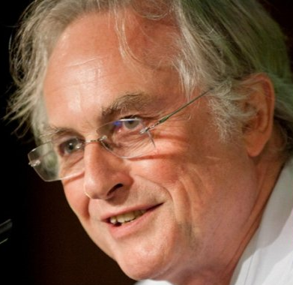
“It could be that at some earlier time, somewhere in the Universe, a civilization evolved by, probably, some kind of Darwinian means, to a very, very high level of technology, and designed a form of life that they seeded onto, perhaps, this planet.
Richard Dawkins
British evolutionary biologist
Notes:
READ Quote. CLICK
(https://books.google.com/books?id=rO_mAwAAQBAJ&pg=PA387&lpg=PA387&dq#v=onepage&q&f=false)

Slide 8
Now that is a possibility, and an intriguing possibility. And I suppose it’s possible that you might find evidence for that, if you look at the details of our chemistry, molecular biology, you might find a signature of some kind of designer.
Richard Dawkins
British evolutionary biologist
Notes:
Continue to READ Quote. CLICK
(https://books.google.com/books?id=rO_mAwAAQBAJ&pg=PA387&lpg=PA387&dq#v=onepage&q&f=false)

Slide 9
And that designer could well be a higher intelligence from elsewhere in the Universe.”
Richard Dawkins
British evolutionary biologist
Notes:
Continue to READ Quote. CLICK
(https://books.google.com/books?id=rO_mAwAAQBAJ&pg=PA387&lpg=PA387&dq#v=onepage&q&f=false)

Slide 10
And that designer could well be a higher intelligence from elsewhere in the Universe.”
Richard Dawkins
British evolutionary biologist
Notes:
According to Dawkins, one of the most famous evolutionists of our time, said when we look at our chemistry — our molecular biology — he admits, CLICK
(https://books.google.com/books?id=rO_mAwAAQBAJ&pg=PA387&lpg=PA387&dq#v=onepage&q&f=false)

Slide 11
Dawkins admits:
Evidence of design
Design implies a designer
Richard Dawkins
British evolutionary biologist
Notes:
there could be evidence of design, and 2nd, which is even more astounding: that design CLICK would imply the existence of a designer. That’s a direct admission, CLICK
teleology. A philosophy of teleology sees purpose in ends rather than stated causes, making the outcome the actual, or "final" cause. When you see things in terms of teleology, you explain actions by their results.

Slide 12
Teleological Argument
Notes:
to the validity of the Teleological Argument. A philosophical argument which many, especially Creationists, argue in favor of. CLICK
teleology. the explanation of phenomena by the purpose they serve rather than by postulated causes.
• Theology the doctrine of design and purpose in the material world.

Slide 13
Teleological Argument
The explanation of phenomena by the purpose they serve rather than by postulated causes.
Notes:
In its simplest definition the Teleological Argument is: READ Quote. When I see design and purpose in the Universe, I see the hand of God. CLICK
teleology. the explanation of phenomena by the purpose they serve rather than by postulated causes.
• Theology the doctrine of design and purpose in the material world.

Slide 14
And I suppose it’s possible that you might find evidence for that, if you look at the details of our chemistry, molecular biology, you might find a signature of some kind of designer.
Richard Dawkins
British evolutionary biologist
Notes:
But, Dawkins, all though he admits to design, he does not see it that way. Instead, he suggests: CLICK READ Quote. CLICK

Slide 15
And I suppose it’s possible that you might find evidence for that, if you look at the details of our chemistry, molecular biology, you might find a signature of some kind of designer.
And that designer could well be a higher intelligence from elsewhere in the Universe.”
Richard Dawkins
British evolutionary biologist
Notes:
READ Yellow Quote. In other words, aliens. CLICK

Slide 16
And I suppose it’s possible that you might find evidence for that, if you look at the details of our chemistry, molecular biology, you might find a signature of some kind of designer.
And that designer could well be a higher intelligence from elsewhere in the Universe.”
Richard Dawkins
British evolutionary biologist
Notes:
The problem is, there is no scientific evidence for the existence of aliens, so there can hardly be any evidence for their planting life on Earth. CLICK

Slide 17
They’re desperately searching
Notes:
Which is why Evolutionists are so desperately searching, and are spending billions of our dollars looking for life out there. CLICK

Slide 18
Someday we may find it
That’s called: Faith!
Notes:
They say ‘someday we may find it’. You know what that’s called? CLICK That’s called ‘faith’ and ‘hope’. CLICK

Slide 19
Someday we may find it
That’s called: Faith!
Notes:
Having Faith and Hope is not in keeping with even Dawkins’ own claims about the importance of direct observation and experimentation in science. CLICK

Slide 20
Mr. Dawkins ‘Alien’ theory
actually admits:
Law of Biogenesis
Life only comes from life
Notes:
In essence, Mr. Dawkins ‘Alien’ theory actually admits CLICK the truth of the Law of Biogenesis which states: CLICK in the natural world, life only comes from life. It can’t come from rocks. CLICK

Slide 21
Mr. Dawkins ‘Alien’ theory
actually admits:
Necessity of a Creator
a Designer is in the equation
Notes:
And 2nd he admits the necessity of a creator. i.e. CLICK there’s a designer somewhere in the equation. However, in his theory, he says its Aliens. CLICK

Slide 22
Mr. Dawkins ‘Alien’ theory
actually admits:
Necessity of a Creator
a Designer is in the equation
Notes:
But the problem with his fanciful suggestion is that if aliens were to exist, they too would be beings of nature governed by natural law. CLICK
Ref: “Curiosity: Did God Create the Universe?” (2011), Discovery Channel, August 7, emp. added.

Slide 23
Stephen Hawking, 1942 - 2018
Theoretical physicist, cosmologist, author
Laws of Physics
are universal
Notes:
The late, famous evolutionist Stephen Hawking, admitted that natural law: CLICK i.e. the laws of physics, “are universal. In fact there’s not a scientist alive who disagrees with that. CLICK
Ref: “Curiosity: Did God Create the Universe?” (2011), Discovery Channel, August 7, emp. added.

Slide 24
Stephen Hawking, 1942 - 2018
Theoretical physicist, cosmologist, author
Laws of Physics
are universal
Notes:
Science lives under that law. It applies not just to the flight of a baseball, but to the motion of a planet and everything else in the Universe.
CLICK
Ref: “Curiosity: Did God Create the Universe?” (2011), Discovery Channel, August 7, emp. added.

Slide 25
Who Created the Universe?
evolutionists offer unscientific solution
“Conservation of energy and other basic laws hold true in the most distant observed galaxy and in the cosmic microwave background, implying that these laws have been valid for over thirteen billion years.”
Victor J. Stenger, 1935 - 2014
Philosopher, skeptic, author,
God: The Failed Hypothesis: How Science Shows That God Does not Exist, 2010, pg 115
Notes:
However, Philosopher and Skeptic, Victor Stenger, in his book, God: The Failed Hypothesis: How Science Shows That God Does Not Exist, stated: CLICK READ Quote.
CLICK
https://books.google.com/books?id=XIHDbfAAfBAC&pg=PA115&lpg=PA115&dq=“hold+true+in+the+most+distant+observed+galaxy+and+in+the+cosmic+microwave+background#v=onepage&q=“hold%20true%20in%20the%20most%20distant%20observed%20galaxy%20and%20in%20the%20cosmic%20microwave%20background&f=false
Expelled: https://www.amazon.com/s/ref=nb_sb_noss_2?url=search-alias%3Daps&field-keywords=expelled%3A+no+intelligence+allowed

Slide 26
“But that higher intelligence would, itself, had to have come about by some ultimately explicable process. It couldn’t have just jumped into existence spontaneously.”
Richard Dawkins
British evolutionary biologist
Notes:
Back to Dawkins and his Alien theory, he went on to say: CLICK READ Quote. That’s exactly right. That’s the Law of Biogenesis. CLICK
ibid

Slide 27
“But that higher intelligence would, itself, had to have come about by some ultimately explicable process. It couldn’t have just jumped into existence spontaneously.”
Richard Dawkins
British evolutionary biologist
Notes:
You see, even Dawkins admits, that if Aliens existed, they would be strapped with the same laws of nature as us. CLICK

Slide 28
“But that higher intelligence would, itself, had to have come about by some ultimately explicable process. It couldn’t have just jumped into existence spontaneously.”
Richard Dawkins
British evolutionary biologist
Notes:
Thus, his problem of abiogenesis, life only comes from Life, is merely shifted to the alien’s abode. Where the question of the origin of life is still unanswered. CLICK

Slide 29
Who Created the Universe?
evolutionists offer unscientific solution
Notes:
Bottom line: life is evidence of design, and by implication, an intelligent designer. Writing in New Scientist, Dawkins admitted, “The more statistically improbable a thing is, the less we can believe that it just happened by blind chance. Superficially the obvious alternative to chance is an intelligent Designer.” CLICK
Richard Dawkins (1982), “The Necessity of Darwinism,” New Scientist, 94:130, April 15, emp. added

Slide 30
Who Created the Universe?
evolutionists try to ignore the question
Notes:
Sadly, the atheist simply cannot bring himself to accept the clear cut, “obvious alternative” that is staring him in the face. The Intelligent Designer himself. CLICK

Slide 31
Evolutionary theory
is a Religion of ‘Faith’
and unanswerable questions
Notes:
OK, enough with Atheistic theories, with their religion of ‘faith’ in unanswerable questions. We on the other hand have a direct answer to our question, CLICK

Slide 32
Who Created the Universe?
Notes:
“Who Created the Universe?” There’s no hemming or hawing, or possible suggestions and theories from the apostle John. He just comes straight out with the answer as if its a fact. CLICK

Slide 33
1 In the beginning was the Word, and the Word was with God, and the Word was God.
2 He was in the beginning with God.
3 All things were made through him, and without him was not any thing made that was made.
4 In him was life, and the life was the light of men.
John 1
ESV
Notes:
READ John 1:1-4. i.e. Life only comes from Life. CLICK

Slide 34
1 In the beginning was the Word, and the Word was with God, and the Word was God.
2 He was in the beginning with God.
3 All things were made through him, and without him was not any thing made that was made.
4 In him was life, and the life was the light of men.
John 1
ESV
Notes:
Questioned answered. Problem solved. John claims that the Word was with God and was God. CLICK

Slide 35
1 In the beginning was the Word, and the Word was with God, and the Word was God.
2 He was in the beginning with God.
3 All things were made through him, and without him was not any thing made that was made.
4 In him was life, and the life was the light of men.
John 1
ESV
Notes:
And, the Word was completely involved in all creation. Which BTW, tells us the Word Himself cannot be created. He was God. CLICK

Slide 36
10 He was in the world, and the world was made through him, yet the world did not know him.
11 He came to his own, and his own people did not receive him.
12 But to all who did receive him, who believed in his name, he gave the right to become children of God,
13 who were born, not of blood nor of the will of the flesh nor of the will of man, but of God.
Notes:
John continues, READ John 1:10-12, Then in verse 14. CLICK

Slide 37
14 And the Word became flesh and dwelt among us, and we have seen his glory, glory as of the only Son from the Father, full of grace and truth.
John 1
ESV
Notes:
READ John 1:14. The Word came into the world as a human being, to dwell among men. John said the Word was the Son of God. Jesus Christ. CLICK

Slide 38
14 And the Word became flesh and dwelt among us, and we have seen his glory, glory as of the only Son from the Father, full of grace and truth.
John 1
ESV
Notes:
John doesn't just make this bold statement that Jesus was God without giving evidence. He starts with things like this. CLICK

Slide 39
45 Philip found Nathanael and said to him, “We have found him of whom Moses in the Law and also the prophets wrote, Jesus of Nazareth, the son of Joseph.”
46 Nathanael said to him, “Can anything good come out of Nazareth?” Philip said to him, “Come and see.”
John 1
ESV
Notes:
READ John 1:45-47. CLICK

Slide 40
47 Jesus saw Nathanael coming toward him and said of him, “Behold, an Israelite indeed, in whom there is no deceit!”
48 Nathanael said to him, “How do you know me?” Jesus answered him, “Before Philip called you, when you were under the fig tree, I saw you.”
49 Nathanael answered him, “Rabbi, you are the Son of God! You are the King of Israel!”
John 1
ESV
Notes:
READ John 1:48-49. CLICK

Slide 41
47 Jesus saw Nathanael coming toward him and said of him, “Behold, an Israelite indeed, in whom there is no deceit!”
48 Nathanael said to him, “How do you know me?” Jesus answered him, “Before Philip called you, when you were under the fig tree, I saw you.”
49 Nathanael answered him, “Rabbi, you are the Son of God! You are the King of Israel!”
John 1
ESV
Notes:
Before meeting Nathaniel, Jesus knew who he was, where he was and what he was doing when Philip found him. CLICK

Slide 42
Who is this Jesus?
Notes:
So this is the question people should really be asking is, Who is this Jesus? That’s the question of the ages. CLICK

Slide 43
Notes:
That’s also a question that so many people struggle with, or don’t really care to know. CLICK

Slide 44
Notes:
Well, Nathanael knew who Jesus was. He understood the significance of what Jesus said to him, and about him. CLICK

Slide 45
Omnipresent
Seeing events when not present
Notes:
Jesus was omnipresent — CLICK i.e. He saw events where he was not even physically present. CLICK

Slide 46
Omnipresent
Seeing events when not present
Notes:
We have a good example of that surrounding Jesus’ good friend Lazarus. Remember when Lazarus’ sisters sent word to Jesus, about their brother being very sick? CLICK

Slide 47
Omnipresent
Seeing events when not present
Notes:
Jesus purposely waited a few days before going to him. After which he said this: CLICK READ John 11:11-15. CLICK

Slide 48
11 After saying these things, he said to them, “Our friend Lazarus has fallen asleep, but I go to awaken him.”
12 The disciples said to him, “Lord, if he has fallen asleep, he will recover.”
13 Now Jesus had spoken of his death, but they thought that he meant taking rest in sleep.
14 Then Jesus told them plainly, “Lazarus has died,
15 and for your sake I am glad that I was not there, so that you may believe. But let us go to him.”
John 11
ESV
Notes:
READ John 11:11-15. CLICK

Slide 49
11 After saying these things, he said to them, “Our friend Lazarus has fallen asleep, but I go to awaken him.”
12 The disciples said to him, “Lord, if he has fallen asleep, he will recover.”
13 Now Jesus had spoken of his death, but they thought that he meant taking rest in sleep.
14 Then Jesus told them plainly, “Lazarus has died,
15 and for your sake I am glad that I was not there, so that you may believe. But let us go to him.”
John 11
ESV
Notes:
Jesus was about 20 miles away from where Lazarus was, and yet he knew exactly the moment when Lazarus died. That’s omnipresent. CLICK

Slide 50
49 The official said to him, “Sir, come down before my child dies.”
50 Jesus said to him, “Go; your son will live.” The man believed the word that Jesus spoke to him and went on his way.
51 As he was going down, his servants met him and told him that his son was recovering.
Omnipresent
Seeing events when not present
John 4
ESV
Notes:
Just like the time he healed a young boy. When the boy’s father heard Jesus was in the area he went out to him. CLICK READ John 4:49-51. CLICK

Slide 51
52 So he asked them the hour when he began to get better, and they said to him, “Yesterday at the seventh hour the fever left him.”
53 The father knew that was the hour when Jesus had said to him, “Your son will live.” . . .
John 4
ESV
Notes:
READ John 4:52-53. Only God is Omnipresent. So what does that make Jesus? CLICK

Slide 52
Omniscience
state of knowing everything
24 But Jesus on his part did not entrust himself to them, because he knew all people
25 and needed no one to bear witness about man, for he himself knew what was in man.
John 2
ESV
Notes:
But Jesus was also Omniscience (Omnesciance). He had the power CLICK to know everything. CLICK READ John 2:24-25. CLICK

Slide 53
Omniscience
state of knowing everything
24 But Jesus on his part did not entrust himself to them, because he knew all people
25 and needed no one to bear witness about man, for he himself knew what was in man.
John 2
ESV
Notes:
Jesus knew the past lives of people whom he only just met, as we saw with Nathanael. We also see that with the Samaritan woman at the well. CLICK

Slide 54
Omniscience
state of knowing everything
17 The woman answered him, “I have no husband.” Jesus said to her, “You are right in saying, ‘I have no husband’;
18 for you have had five husbands, and the one you now have is not your husband. What you have said is true.”
19 The woman said to him, “Sir, I perceive that you are a prophet.
John 4
ESV
Notes:
Towards the end of his conversation with her, Jesus suggested she go home and come back with her husband. CLICK READ John 4:17-19. CLICK

Slide 55
Omniscience
state of knowing everything
28 So the woman left her water jar and went away into town and said to the people,
29 “Come, see a man who told me all that I ever did. Can this be the Christ?”
John 4
ESV
Notes:
Then dropping down to verse 28: CLICK READ John 4:28-29. CLICK

Slide 56
Omniscience
state of knowing everything
28 So the woman left her water jar and went away into town and said to the people,
29 “Come, see a man who told me all that I ever did. Can this be the Christ?”
John 4
ESV
Notes:
She understood the significance of this stranger, knowing her past history and present condition. No man could have perceived such details. Only God can. CLICK

Slide 57
Jesus
the Son of God
17 But Jesus answered them, “My Father is working until now, and I am working.”
18 This was why the Jews were seeking all the more to kill him, because not only was he breaking the Sabbath, but he was even calling God his own Father, making himself equal with God.
John 5
ESV
Notes:
Jesus is the Son of God and claimed to be equal with God. CLICK READ John 5:17-18. CLICK

Slide 58
Jesus
the Son of God
17 But Jesus answered them, “My Father is working until now, and I am working.”
18 This was why the Jews were seeking all the more to kill him, because not only was he breaking the Sabbath, but he was even calling God his own Father, making himself equal with God.
John 5
ESV
Notes:
Jesus not only claims he’s involved in the same work with God, but he declared himself to be equal with God. CLICK

Slide 59
Jesus
the Son of God
17 And he is before all things, and in him all things hold together.
Colossians 1
ESV
Notes:
And what’s interesting, add to that what the apostle Paul said: CLICK READ Colossians 1:17. That’s amazing. CLICK

Slide 60
Jesus
the Son of God
17 And he is before all things, and in him all things hold together.
Colossians 1
ESV
Notes:
Jesus is holding everything in existence, together. That includes this entire magnificent Universe. The Jews understood exactly what Jesus was saying. And for that they sought to kill him, accusing him of blasphemy. CLICK

Slide 61
Omnipotent
all powerful
Notes:
John also records other characteristics which Jesus possessed showing that CLICK he’s Omnipotent, meaning all powerful. CLICK

Slide 62
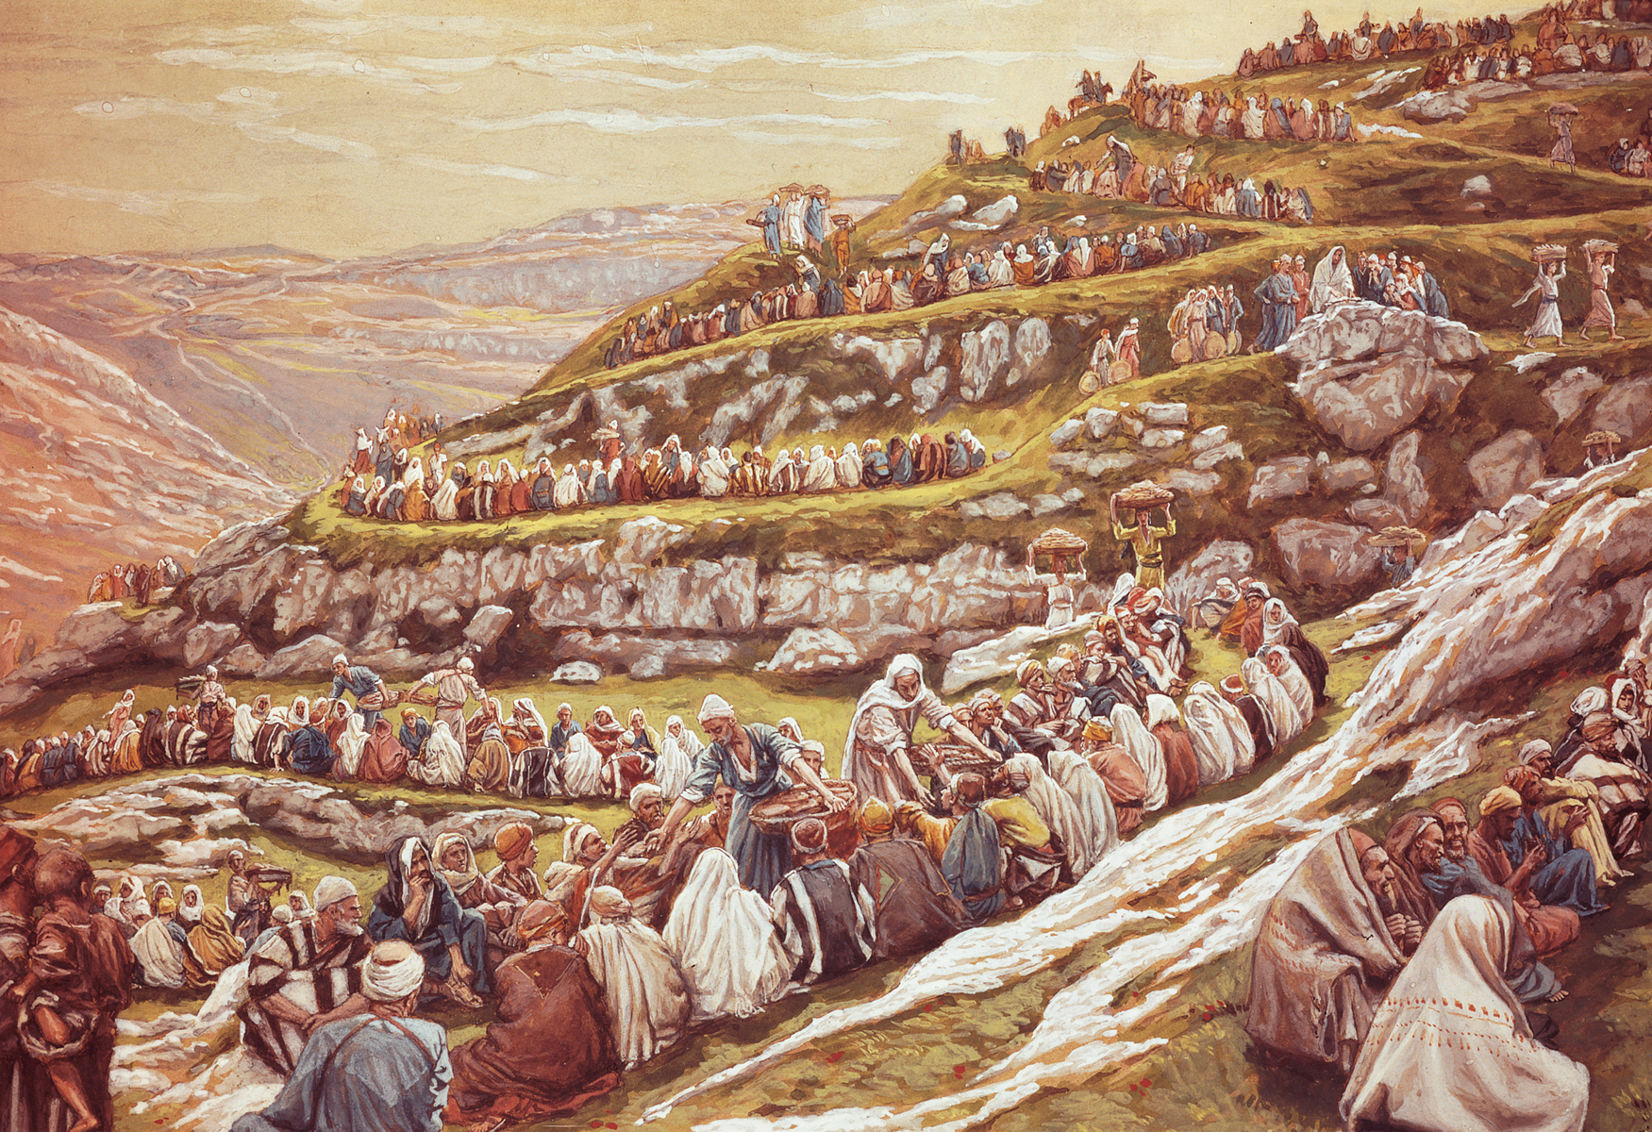
Omnipotent
all powerful
Fed 5000+
John 6:1-14
Notes:
Such as when he fed 5,000 men plus an unknown number of women and children. He did that from just five loaves of bread and two fishes. Such a feat is physically impossibility. CLICK

Slide 63
Omnipotent
all powerful
Walked on water John 6:16-21
Notes:
Or the time when he walked on water in the middle of a storm. Demonstrating total control and power over the physical laws of the universe. CLICK

Slide 64
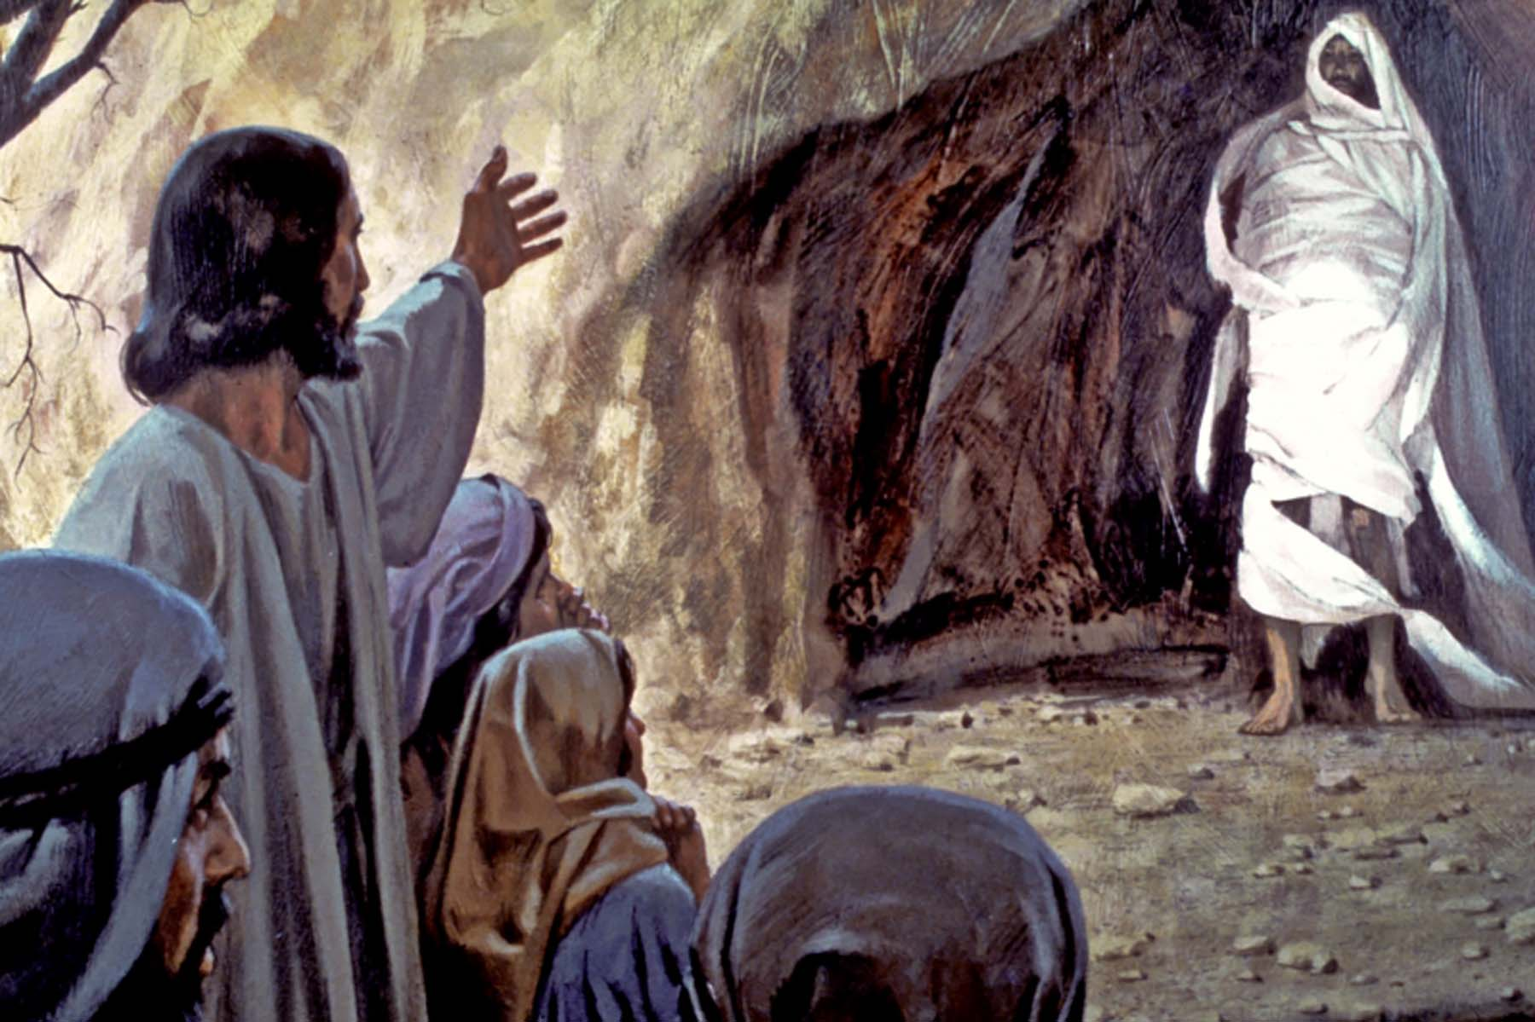
Omnipotent
all powerful
Raised Lazarus
from the dead
John 6:16-21
Notes:
Jesus raised Lazarus from the dead when he finally went to him. These events, and so many others like them, tell us that Jesus was omnipotent. CLICK

Slide 65
35 Jesus said to them, “I am the bread of life; whoever comes to me shall not hunger, and whoever believes in me shall never thirst.
John 6
ESV
Notes:
In addition to doing great miracles, Jesus made the most amazing claims about himself. CLICK READ John 6:35. This flies in the face of sanity if in fact that’s not true. CLICK

Slide 66
38 For I have come down from heaven, not to do my own will but the will of him who sent me. . .
40 For this is the will of my Father, that everyone who looks on the Son and believes in him should have eternal life, and I will raise him up on the last day.”
John 6
ESV
Notes:
Then he further explains it with these statements: CLICK READ John 6:38. Then in verse 40: CLICK READ John 6:40. CLICK

Slide 67
38 For I have come down from heaven, not to do my own will but the will of him who sent me. . .
40 For this is the will of my Father, that everyone who looks on the Son and believes in him should have eternal life, and I will raise him up on the last day.”
John 6
ESV
Notes:
He came done from heaven? He can give eternal life? The Jews did not take kindly to any of this. CLICK

Slide 68
41 So the Jews grumbled about him, because he said, “I am the bread that came down from heaven.”
42 They said, “Is not this Jesus, the son of Joseph, whose father and mother we know? How does he now say, ‘I have come down from heaven’?”
John 6
ESV
Notes:
READ John 6:41-42. CLICK

Slide 69
41 So the Jews grumbled about him, because he said, “I am the bread that came down from heaven.”
42 They said, “Is not this Jesus, the son of Joseph, whose father and mother we know? How does he now say, ‘I have come down from heaven’?”
John 6
ESV
Notes:
Exactly my point. What man could state that he came to earth from heaven? No one can. Yet, Jesus said it. CLICK

Slide 70
47 Truly, truly, I say to you, whoever believes has eternal life.
48 I am the bread of life.
49 Your fathers ate the manna in the wilderness, and they died.
John 6
ESV
Notes:
And he didn’t stop there. He continued. CLICK READ John 6:47-49. CLICK

Slide 71
50 This is the bread that comes down from heaven, so that one may eat of it and not die.
51 I am the living bread that came down from heaven. If anyone eats of this bread, he will live forever. And the bread that I will give for the life of the world is my flesh.”
John 6
ESV
Notes:
READ John 6:50-51. These are bold statements. Could Jesus have said anything more bold? Yes, in fact he does. But before we read it, I need to set the table. CLICK

Slide 72
23 He said to them, “You are from below; I am from above. You are of this world; I am not of this world.
24 I told you that you would die in your sins, for unless you believe that I am he you will die in your sins.”
John 8
ESV
Notes:
And he didn’t stop: READ John 8:23-24. CLICK
On the surface, that may not sound more bold than what he said previously.

Slide 73
13 Then Moses said to God, “If I come to the people of Israel and say to them, ‘The God of your fathers has sent me to you,’ and they ask me, ‘What is his name?’ what shall I say to them?”
Exodus 3
ESV
Notes:
Remember when Moses was before the burning bush? When God was speaking with him. At this time in Israel’s history they were slaves in Egypt for hundreds of years. And nobody knew God’s name. Not even Moses. CLICK READ Exodus 3:13. CLICK

Slide 74
14 God said to Moses, “I am who I am.” And he said, “Say this to the people of Israel: ‘I am has sent me to you.’”
15 God also said to Moses, “Say this to the people of Israel: ‘The Lord, the God of your fathers, the God of Abraham, the God of Isaac, and the God of Jacob, has sent me to you.’ This is my name forever, and thus I am to be remembered throughout all generations.
Exodus 3
ESV
Notes:
READ Exodus 3:14-15. CLICK

Slide 75
“I AM” is God’s name
His unique and eternal self existence
Notes:
"I AM” is God’s name. It indicates His unique and eternal self-existence. No created being can rightly claim to be "I AM.” And so now lets turn our attention to what Jesus said in John 8. CLICK

Slide 76
23 He said to them, “You are from below; I am from above. You are of this world; I am not of this world.
24 I told you that you would die in your sins, for unless you believe that I am he you will die in your sins.”
John 8
ESV
Notes:
But the pronoun "He" is not in the original Greek text. The translators supplied it to make the translation read more smoothly in English. CLICK

Slide 77
23 He said to them, “You are from below; I am from above. You are of this world; I am not of this world.
24 I told you that you would die in your sins, for unless you believe that I am he you will die in your sins.”
John 8
ESV
Notes:
But by adding the English word ‘he’ it misses the point that Jesus was making. CLICK Jesus said, “I Am”. He is God. And he tells them, that if they don’t believe who he is, they will die in their sins. CLICK

Slide 78
51 Truly, truly, I say to you, if anyone keeps my word, he will never see death.”
52 The Jews said to him, “Now we know that you have a demon! Abraham died, as did the prophets, yet you say, ‘If anyone keeps my word, he will never taste death.’
John 8
ESV
Notes:
READ John 8:51-52. CLICK

Slide 79
53 Are you greater than our father Abraham, who died? And the prophets died! Who do you make yourself out to be?”
54 Jesus answered, “If I glorify myself, my glory is nothing. It is my Father who glorifies me, of whom you say, ‘He is our God.’
John 8
ESV
Notes:
READ John 8:53-54. CLICK

Slide 80
55 But you have not known him. I know him. If I were to say that I do not know him, I would be a liar like you, but I do know him and I keep his word.
56 Your father Abraham rejoiced that he would see my day. He saw it and was glad.”
John 8
ESV
Notes:
READ John 8:55-56. CLICK

Slide 81
57 So the Jews said to him, “You are not yet fifty years old, and have you seen Abraham?”
58 Jesus said to them, “Truly, truly, I say to you, before Abraham was, I am.”
59 So they picked up stones to throw at him, but Jesus hid himself and went out of the temple.
John 8
ESV
Notes:
READ John 8:57-59. CLICK

Slide 82
57 So the Jews said to him, “You are not yet fifty years old, and have you seen Abraham?”
58 Jesus said to them, “Truly, truly, I say to you, before Abraham was, I am.”
59 So they picked up stones to throw at him, but Jesus hid himself and went out of the temple.
John 8
ESV
Notes:
When Jesus claimed God’s unique name, "I AM”, The Jews understood full well that he claimed to be God. That’s why they sought to kill him. CLICK

Slide 83
Notes:
Later, Jesus makes the same claim to His disciples while washing their feet. "I do not speak concerning all of you. I know whom I have chosen; but that the Scripture may be fulfilled, 'He who eats bread with Me has lifted up his heel against Me.' Now I tell you before it comes, that when it does come to pass, you may believe that I am [He]" (John 13:18-19). CLICK

Slide 84
55 But you have not known him. I know him. If I were to say that I do not know him, I would be a liar like you, but I do know him and I keep his word.
56 Your father Abraham rejoiced that he would see my day. He saw it and was glad.”
57 So the Jews said to him, “You are not yet fifty years old, and have you seen Abraham?”
58 Jesus said to them, “Truly, truly, I say to you, before Abraham was, I am.”
59 So they picked up stones to throw at him, but Jesus hid himself and went out of the temple.
John 8
ESV
Notes:
And try they did. Several times they almost had him, but they failed. That’s why the needed help from someone like Judas. CLICK

Slide 85
3 So Judas, having procured a band of soldiers and some officers from the chief priests and the Pharisees, went there with lanterns and torches and weapons.
4 Then Jesus, knowing all that would happen to him, came forward and said to them, “Whom do you seek?”
John 18
ESV
Notes:
But when they finally were able to arrest him that night in the garden, something interesting happened. CLICK READ John 18:3-4. CLICK

Slide 86
5 They answered him, “Jesus of Nazareth.” Jesus said to them, “I am he.” Judas, who betrayed him, was standing with them.
6 When Jesus said to them, “I am he,” they drew back and fell to the ground.
7 So he asked them again, “Whom do you seek?” And they said, “Jesus of Nazareth.”
8 Jesus answered, “I told you that I am he. So, if you seek me, let these men go.”
John 18
ESV
Notes:
READ John 18:5-8. It was always puzzling to me why the mob fell on their faces. The passage actually says they fell down to the ground. CLICK

Slide 87
5 They answered him, “Jesus of Nazareth.” Jesus said to them, “I am he.” Judas, who betrayed him, was standing with them.
6 When Jesus said to them, “I am he,” they drew back and fell to the ground.
7 So he asked them again, “Whom do you seek?” And they said, “Jesus of Nazareth.”
8 Jesus answered, “I told you that I am he. So, if you seek me, let these men go.”
John 18
ESV
Notes:
After all, they were searching for Jesus and all he told them was that they had found the right man. CLICK

Slide 88
5 They answered him, “Jesus of Nazareth.” Jesus said to them, “I am he.” Judas, who betrayed him, was standing with them.
6 When Jesus said to them, “I am he,” they drew back and fell to the ground.
7 So he asked them again, “Whom do you seek?” And they said, “Jesus of Nazareth.”
8 Jesus answered, “I told you that I am he. So, if you seek me, let these men go.”
John 18
ESV
Notes:
What’s so terrifying about that? But, remember these are Jews. The guards were Temple guards. Jesus didn’t just say “I’m the guy you’re looking for.” CLICK

Slide 89
5 They answered him, “Jesus of Nazareth.” Jesus said to them, “I am he.” Judas, who betrayed him, was standing with them.
6 When Jesus said to them, “I am he,” they drew back and fell to the ground.
7 So he asked them again, “Whom do you seek?” And they said, “Jesus of Nazareth.”
8 Jesus answered, “I told you that I am he. So, if you seek me, let these men go.”
5 They answered him, “Jesus of Nazareth.” Jesus said to them, “I am he.” Judas, who betrayed him, was standing with them.
6 When Jesus said to them, “I am he,” they drew back and fell to the ground.
7 So he asked them again, “Whom do you seek?” And they said, “Jesus of Nazareth.”
8 Jesus answered, “I told you that I am he. So, if you seek me, let these men go.”
John 18
John 18
ESV
ESV
Notes:
He declared to them who he was, by invoking the CLICK name of God -- "I AM" — The word ‘he’ is not in the original Greek. Human translators added it. CLICK

Slide 90
5 They answered him, “Jesus of Nazareth.” Jesus said to them, “I am he.” Judas, who betrayed him, was standing with them.
6 When Jesus said to them, “I am he,” they drew back and fell to the ground.
7 So he asked them again, “Whom do you seek?” And they said, “Jesus of Nazareth.”
8 Jesus answered, “I told you that I am he. So, if you seek me, let these men go.”
John 18
ESV
Notes:
Now we can understand the terror these men felt. The very statement of Jesus declaring God’s name, "I AM," causes even the wicked to fall before Him. CLICK

Slide 91
9 Therefore God has highly exalted him and bestowed on him the name that is above every name,
10 so that at the name of Jesus every knee should bow, in heaven and on earth and under the earth,
11 and every tongue confess that Jesus Christ is Lord, to the glory of God the Father.
Philippians 2
ESV
Notes:
Truly, Jesus was the fullness of deity coming to earth in bodily form. In Philippians Paul wrote: CLICK READ Philippians 2:9-11. CLICK

Slide 92
9 For in him the whole fullness of deity dwells bodily,
10 and you have been filled in him, who is the head of all rule and authority.
Colossians 2
ESV
Notes:
In Colossians: READ Colossians 2:9-10. Not just some fullness, but the whole fullness of deity. CLICK

Slide 93
Jesus Christ
Creator, Intelligent Designer
Notes:
Jesus Christ was the Creator of the Universe. And he continues to hold it all together. The inspired Word of God reveals the details of all of this and gives us the answers to our questions. CLICK

Slide 94
Jesus Christ
Creator, Intelligent Designer
Notes:
And the physical evidence of design and purpose in the Universe shows the works of his powerful hand. CLICK

Slide 95
In whom will you trust
your very life with?
Notes:
And so the question now becomes, who would you place your complete trust in? CLICK Into who’s hands would you place your life. Mere humans, atheists with unanswered theories? CLICK

Slide 96
In whom will you trust
your very life with?
Notes:
There’s only one who you can confidently trust your life with. Jesus Christ. There’s no one else for us to worship and give glory to. CLICK

Slide 97
. . . there is salvation in no one else, for there is no other name under heaven given among men by which we must be saved.
Acts 4:12
ESV
Notes:
Because READ Acts 4:12. Everyone of us needs salvation. And it’s the scriptures which gives us all the details and facts of our Savior Jesus Christ, the Son of God. CLICK

Slide 98
Notes:
I hope you have further questions in your mind about eternal life, about the Universe, and about it’s Creator? If so, I’m confident there are those here who will gladly help you. Thank you for your attention. CLICK to End.

