Slide 1
Study of Solomon
Lesson 2

Slide 2
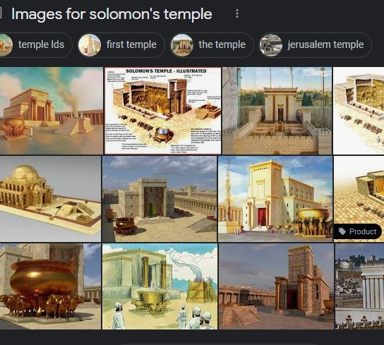
Renderings of Solomon’s Temple
Many interpretations

Slide 3
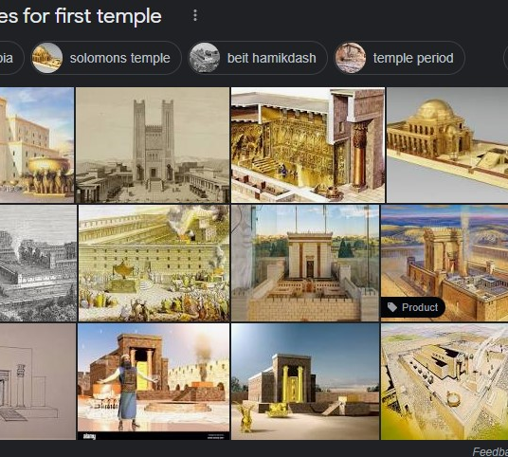
Renderings of Solomon’s Temple
Many interpretations

Slide 4
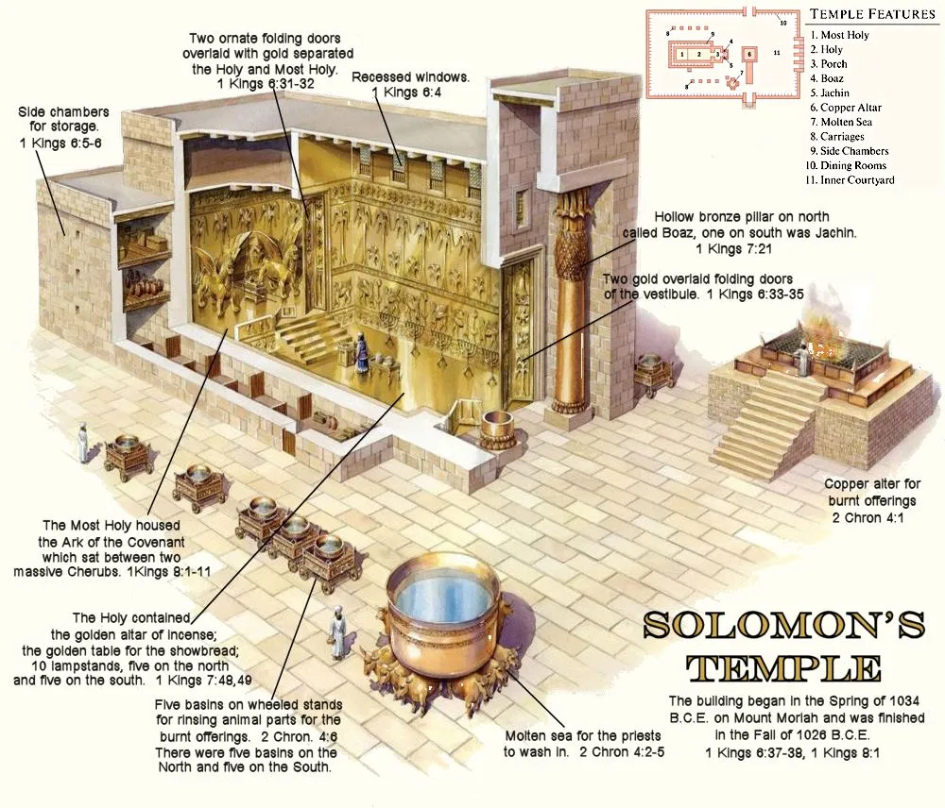
Renderings of Solomon’s Temple
Many interpretations

Slide 5
Renderings of Solomon’s Temple
Many interpretations

Slide 6
Temple footprint
Length – 60 cubits (90 feet)
Width – 20 cubits (30 feet)

Slide 7
Temple elevation view
Length 60 cubits (90 feet)
Height 30 cubits (45 feet)

Slide 8
Temple footprint and vestibule
Temple 20 x 60 cubits (30 x 90 feet)
Vestibule 20 x 10 cubits ( 30 x 15 feet)

Slide 9
Temple and vestibule elevation view
Temple height and length 30 cubits x 60 cubits (45 feet x 90 feet)
Vestibule Length 10 cubits (15 feet) Height 20, 30, or 120 cubits (30, 45, or 180 feet)

Slide 10
Temple plan view with Most Holy Place
Temple 20 x 60 cubits (30 x 90 feet)
Vestibule 20 x 10 cubits (30 x 15 feet)
Most Holy Place 20 x 20 cubits (30 x 30 feet)

Slide 11
Temple elevation view with Most Holy Place
Temple 30 cubits x 60 cubits (45 feet x 90 feet)
Vestibule 30 cubits x 10 cubits (45 feet x 15 feet)
Most Holy Place 20 cubits x 20 cubits (30 feet x 30 feet)

Slide 12
Temple vs Tabernacle
Temple footprint (less vestibule) – 20 x 60 cubits (30 x 90 feet)
Temple Most Holy Place – 20 x 20 cubits (30 x 30 feet)
Tabernacle footprint – 10 x 30 cubits (15 x 45 feet)
Tabernacle Most Holy Place – 10 x 10 cubits (15 x 15 feet)

Slide 13
Items outside Temple
Chambers – three levels around the temple
Each 5 cubits high (7.5 feet)
Bottom level 5 cubits wide (7.5 feet), middle level 6 cubits wide (9 feet), top level 7 cubits wide (10.5 feet)
PLAN VIEW
ELEVATION VIEW

Slide 14
Items outside Temple
Pillars – 18 cubits (27 feet) tall plus 5 cubit (7.5 feet) capitals with decorations above that; 12 cubit circumference (5 ¾ feet diameter)
Placed outside temple

Slide 15
Items outside Temple
Altar – 20 x 20 cubits (30 x 30 feet)
5 x 5 cubit altar for tabernacle

Slide 16
Items outside Temple
Sea – diameter 10 cubits (15 feet) – contained 3000 baths (1 bath is approximately 5.75 gallons)
Sitting on 12 carved oxen - 3 facing North, 3 South, 3 East, and 3 West

Slide 17
Items outside Temple
10 Lavers and carts – 4 x 4 cubit carts with 4 cubit diameter lavers sitting on carts
Carts set on each side of Sea

