Slide 1
ETDS 2017
Daniel 10:1-11:35
¹⁴ “Now I have come to give you an understanding of what will happen to your people in the latter days, for the vision pertains to the days yet future.”
Daniel 10
Daniel 11-12
what will happen

Slide 2
OT books written
NT
400 yrs
of
Silence
Daniel

Slide 3
OT books written
NT
400 yrs
of
Silence
Daniel

Slide 4
Daniel 2
Medo Persia
Roman
Babylon
Greece
OT books written
NT
Daniel

Slide 5
Daniel 7
Medo Persia
Roman
Babylon
Greece
OT books written
NT
Daniel

Slide 6
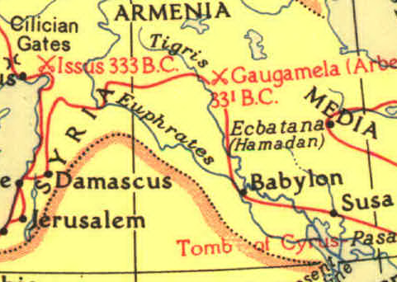
Daniel 8
Medo Persia
Greece
OT books written
NT
GOAT
Conspicuous horn (Alexander)
broken, replaced by four horns
one small horn (Antiochus Epiphanes)
Daniel
RAM
2 horns
one longer than the other

Slide 7
Daniel 10
Medo Persia
OT books written
NT
Daniel
¹⁴ “Now I have come to give you an understanding of what will happen to your people in the latter days, for the vision pertains to the days yet future.”

Slide 8
Daniel 11
Medo Persia
Greece
OT books written
NT
In considerable detail
Daniel
¹⁴ “Now I have come to give you an understanding of what will happen to your people in the latter days, for the vision pertains to the days yet future.”

Slide 9
Questions I can’t answer
Are the beings in 10:5 and 10:16 the same?
Who is the being in 10:5?
Why was Daniel fasting?
Why did Daniel (or do we) need to know that the being in 10:16 aided Darius the Mede?

Slide 10
Two Tasks
Angels of Kingdoms
A Correlation of History & Daniel 11

Slide 11
Two Tasks
Angels of Kingdoms

Slide 12
The heavenly being in Daniel 10:5–6
delayed by “the prince of the kingdom of Persia” (10:13)
aided by Michael, “one of the chief princes.” (10:13)
“The prince of Greece is about to come” (10:20).
Michael is Israel’s prince (10:21).
In the phrase “your prince,” the word “your” is plural.
Dan. 12:1: “Michael, the great prince, who stands guard over the sons of your people.”
Michael came to the assist the one described in Dan. 11:5-6
Michael the Archangel? (Jude 9)
Persia’s prince (10:20) -- a heavenly being associated with Persia
Greece’s prince (10:20) -- a heavenly being associated with Greece

Slide 13
Michael, Israel’s Prince
Prince of the kingdom of Persia
Prince of Greece
Angel of the Church in Ephesus?

Slide 14
The “Angels” of the 7 Churches
Usage in Revelation indicates reference is to heavenly beings
Message to Sardis indicates reference is to heavenly beings

Slide 15
The “Angels” of the 7 Churches
Usage in Revelation indicates reference is to heavenly beings
Occurs 68 times in Revelation
8 occurrences have reference to the 7 churches
All 60 of the other occurrences refer to supernatural beings

Slide 16
The “Angels” of the 7 Churches
Usage in Revelation indicates reference is to heavenly beings
Message to Sardis indicates reference is to heavenly beings

Slide 17
The Structure of the Letters to the Seven Churches
7 letters, 7 sections - "four square"
(1) addressee
(2) identification of the speaker
(3) the "I know" section
(4) rebuke and warning
(5) encouraging admonition
(6) "He that hath an ear...”
(7) "He that overcometh..."

Slide 18
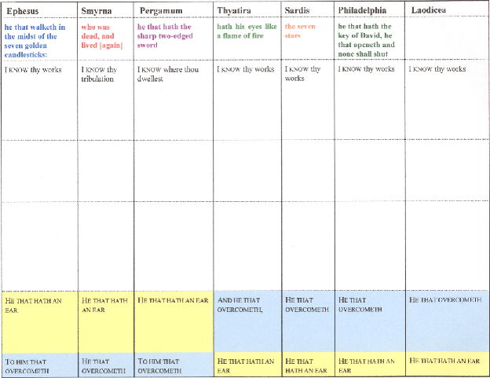

Slide 19
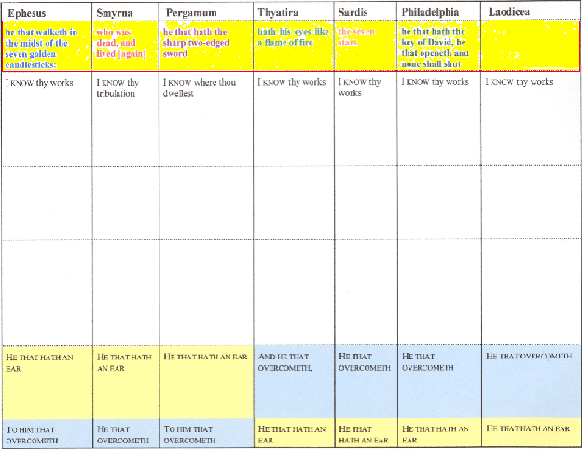

Slide 21
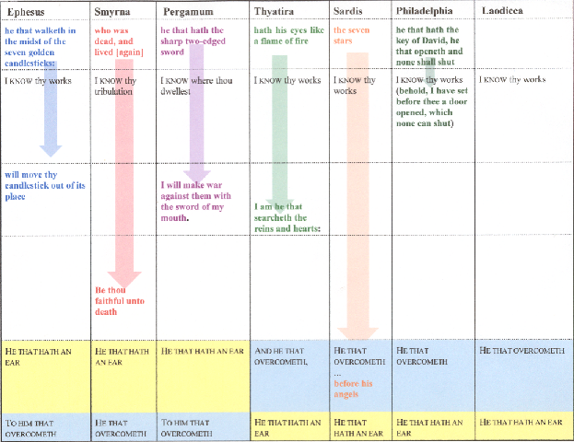

Slide 22
Ephesus
walks in the midst of the seven golden candlesticks
will move thy candlestick out of its place
Smyrna
was dead, and lived
Be thou faithful unto death, and I will give thee the crown of life
Pergamum
has the sharp two-edged sword
I will make war against them with the sword of my mouth
Thyatira
has his eyes like a flame of fire
I am he that searches the reins and hearts
Sardis
has...the seven stars
I will confess his name... before His angels
Philadelphia
has the key of David, he that opens and none shall shut
I have set before thee a door opened, which none can shut

Slide 23
Remember:
“The seven stars are the angels of the seven churches” Rev: 1:20
Sardis
has...the seven stars
I will confess his name... before His angels

Slide 24
Who are these “angels”?
Lk 12:8 “Every one who shall confess me before men, him shall the Son of man also confess before the angels of God
Sardis
I will confess his name...and before His angels

Slide 25
Who are these “angels”?
Heavenly Beings!
Sardis
I will confess his name...and before His angels
…assigned to the churches as Michael was to Israel

Slide 26
Rev. 2:9
“I know thy [singular] tribulation, and thy [singular] poverty (but thou [singular] art rich)…”
Rev. 2:10 “behold, the devil is about to cast some of you [plural] into prison.”
The angel represents the church…
Singular pronouns indicate the angel is addressed throughout each of the letters.
But plural pronouns are used when required by the sense.

Slide 27
we see…
Angels of “little ones” Mt. 18:10
Angels of the devil
Angels of kingdoms
Angels of churches

Slide 28
Revelation 12
Earthly Perspective
Heavenly Perspective
12:1-6
12:5
child was caught up unto God
12:6a
woman fled to the wilderness
12:6b
there they may nourish her
12:6c
1260 days
12:7-17
12:7-13
dragon saw he was cast down
12:14a
she might fly to the wilderness
12:14b
where she is nourished
12:14c
time, and times, and half a time

Slide 29
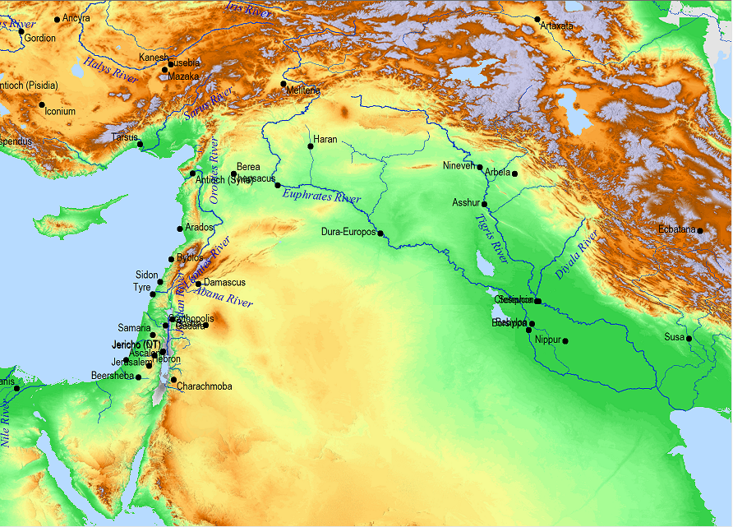
11:2 Now I will tell you the truth. Three more kings will arise for Persia.
11:2 Three more kings
Cambyses (ca. 530-522 B.C.)
Pseudo-Smerdis (ca. 522 B.C.)
Darius I Hystaspes (ca. 522-486 B.C.).

Slide 30
11:2 Now I will tell you the truth. Three more kings will arise for Persia. Then a fourth king will be unusually rich, more so than all who preceded him. When he has amassed power through his riches, he will stir up everyone against the kingdom of Greece.
11:2 fourth king…rich
Xerxes I (ca. 486-465 B.C.)

Slide 31
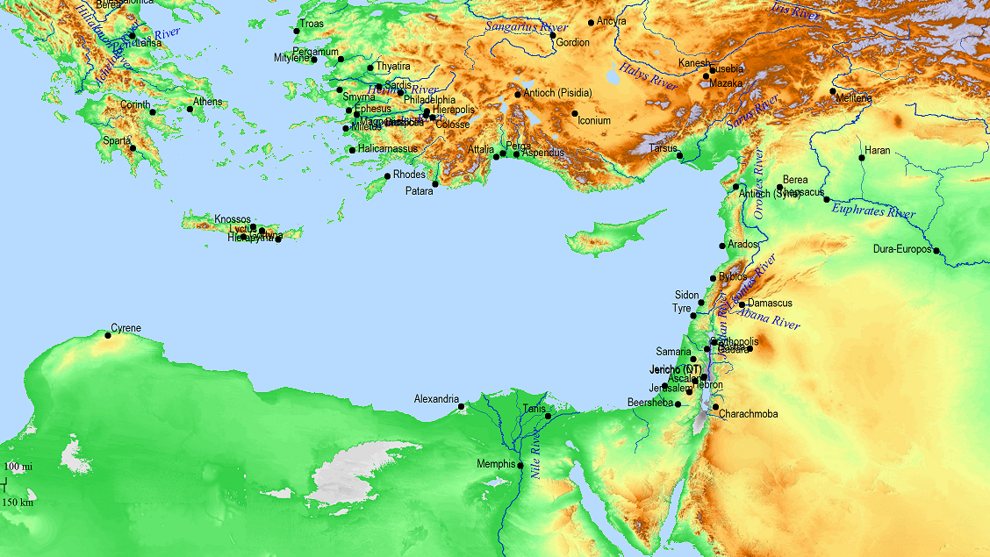
11:3 Then a powerful king will arise
Alexander the Great (ca. 336-323 B.C.)
11:3 Then a powerful king will arise, exercising great authority and doing as he pleases.

Slide 32
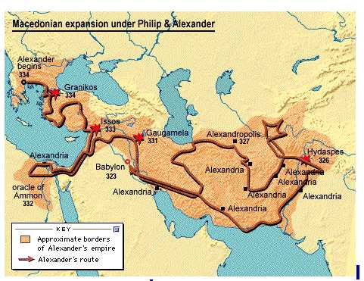
11:3 Then a powerful king will arise, exercising great authority and doing as he pleases.
Alexander

Slide 33
Lysimachus
Antipater
Antigonus I Monophthalmus
(the “one eye”)
The king of the north
Seleucus I Nicator
(ca. 311-280 B.C.)
11:4 Shortly after his rise to power, his kingdom will be broken up and distributed toward the four winds of the sky – but not to his posterity or with the authority he exercised, for his kingdom will be uprooted and distributed to others besides these.
11:4 Shortly after his rise to power, his kingdom will be broken up and distributed toward the four winds of the sky – but not to his posterity or with the authority he exercised, for his kingdom will be uprooted and distributed to others besides these.
11:5 Then the king of the south and one of his subordinates will grow strong. His subordinate will resist him and will rule a kingdom greater than his.
Laomedon
Succeeded by his son…
The king of the south
Ptolemy I Soter (ca. 323-285 B.C.)

Slide 34
Succeeded by his son…
The king of the north
Seleucus I Nicator
(ca. 311-280 B.C.)
Succeeded by his son…
The king of the south
Ptolemy II Philadelphus (ca. 285-246 B.C.)

Slide 35
Succeeded by his son…
The king of the north
Antiochus Soter
(281-261 B.C.)
The king of the south
Ptolemy II Philadelphus (ca. 285-246 B.C.)

Slide 36
The king of the north
Antiochus II Theos
(ca. 261-246 B.C.)
11:6 After some years have passed, they will form an alliance. Then the daughter of the king of the south will come to the king of the north to make an agreement
Laodice
Baby
Seleucus II Calinicus
An Alliance
Then the daughter of the
king of the south will come
to the king of the north to
make an agreement
Berenice
The king of the south
Ptolemy II Philadelphus (ca. 285-246 B.C.)

Slide 37
Laodice
The king of the north
Antiochus II Theos
(ca. 261-246 B.C.)
Baby
Seleucus II Calinicus
Berenice
11:6 After some years have passed, they will form an alliance. Then the daughter of the king of the south will come to the king of the north to make an agreement
11:6 After some years have passed, they will form an alliance. Then the daughter of the king of the south will come to the king of the north to make an agreement but she will not retain her power, nor will he continue in his strength. She, together with the one who brought her, her child, and her benefactor will all be delivered over at that time.
246 B.C.
Baby Antiochus
The king of the south
Ptolemy II Philadelphus (ca. 285-246 B.C.)
Ptolemy III Euergetes

Slide 38
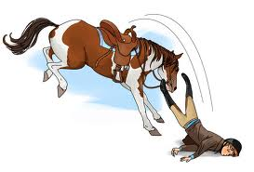
Laodice
Assassinated,
succeeded by his brother…
The king of the north
Antiochus III the Great
(ca. 223-187 B.C.)
The king of the north
Seleucus II Calinicus
(ca. 246-227 B.C.)
The king of the north
Seleucus III Soter
(ca. 225-223 B.C.)
11:7 There will arise in his place one from her family line who will come against their army and will enter the stronghold of the king of the north and will move against them successfully. 11:8 He will also take their gods into captivity to Egypt, along with their cast images and prized utensils of silver and gold. Then he will withdraw for some years from the king of the north.
The king of the south
Ptolemy III Euergetes

Slide 39
The king of the north
Antiochus III the Great
(ca. 223-187 B.C.)
11:9 Then the king of the north will advance against the empire of the king of the south, but will withdraw to his own land. 11:10 His sons will wage war, mustering a large army which will advance like an overflowing river and carrying the battle all the way to the enemy’s fortress.
The king of the south
Ptolemy III Euergetes
The king of the south
Ptolemy IV Philopater
(221-204 B.C.)

Slide 40
The king of the north
Antiochus III the Great
(ca. 223-187 B.C.)
11:9 Then the king of the north will advance against the empire of the king of the south, but will withdraw to his own land. 11:10 His sons will wage war, mustering a large army which will advance like an overflowing river and carrying the battle all the way to the enemy’s fortress.
11:11 “Then the king of the south will be enraged and will march out to fight against the king of the north, who will also muster a large army, but that army will be delivered into his hand.
Battle of Raphia
217 B.C.
The king of the south
Ptolemy V Ephiphanes (child)
(204-181 B.C.)
The king of the south
Ptolemy IV Philopater
(221-204 B.C.)

Slide 41
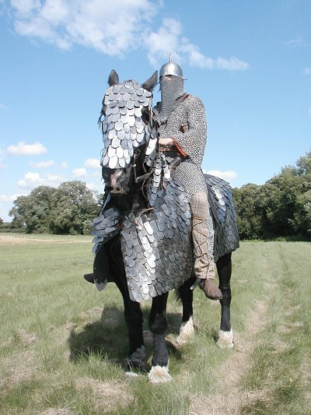
Cataphract
11:15 Then the king of the north will advance and will build siege mounds and capture a well-fortified city. The forces of the south will not prevail, not even his finest contingents. They will have no strength to prevail. 11:16 The one advancing against him will do as he pleases, and no one will be able to stand before him. He will prevail in the beautiful land, and its annihilation will be within his power.
The king of the north
Antiochus III the Great
(ca. 223-187 B.C.)
Battle of Panium
200 B.C.
The king of the south
Ptolemy V Ephiphanes (child)
(204-181 B.C.)

Slide 42
11:17 His intention will be to come with the strength of his entire kingdom, and he will form alliances. He will give the king of the south a daughter in marriage in order to destroy the kingdom, but it will not turn out to his advantage.
The king of the north
Antiochus III the Great
(ca. 223-187 B.C.)
193 B.C.
daughter, Cleopatra
10 years old
The king of the south
Ptolemy V Ephiphanes (child)
(204-181 B.C.)
16 years old

Slide 43
Scipio Asiaticus
11:18 Then he will turn his attention to the coastal regions and will capture many of them. But a commander will bring his shameful conduct to a halt; in addition, he will make him pay for his shameful conduct.
190 B.C.
The king of the north
Antiochus III the Great
(ca. 223-187 B.C.)
The king of the south
Ptolemy V Ephiphanes (child)
(204-181 B.C.)

Slide 44
11:20 There will arise after him one who will send out an exactor of tribute to enhance the splendor of the kingdom, but after a few days he will be destroyed, though not in anger or battle.
The king of the north
Seleucus IV Philopator
(187-175 B.C.)
Heliodorus
2 Maccabees 3
The king of the south
Ptolemy V Ephiphanes
(204-181 B.C.)

Slide 45
The king of the north
Seleucus IV Philopator
(187-175 B.C.)
The king of the south
Cleopatra, on behalf of her son,
Ptolemy VI Philometor, 181 B.C.

Slide 46
Heliodorus
assassinates…
11:21 In his place a despicable person will arise, on whom the honor of kingship has not been conferred, but he will come in a time of tranquility and seize the kingdom by intrigue.
The king of the north
Seleucus IV Philopator
(187-175 B.C.)
brother,
Mithradates
I’ll be co-regent with my nephew!
infant son,
Antiochus
The king of the south
Ptolemy VI Philometor
(176-145 B.C.)

Slide 47
²² The overflowing forces will be flooded away before him and shattered, and also the prince of the covenant. ²³ After an alliance is made with him he will practice deception, and he will go up and gain power with a small force of people. ²⁴ In a time of tranquility he will enter the richest parts of the realm, and he will accomplish what his fathers never did, nor his ancestors; he will distribute plunder, booty and possessions among them, and he will devise his schemes against strongholds, but only for a time.
11:21 In his place a despicable person will arise, on whom the honor of kingship has not been conferred, but he will come in a time of tranquility and seize the kingdom by intrigue.
The king of the north
Antiochus IV Ephiphanes
(175-163 B.C.)
The king of the south
Ptolemy VI Philometor
(176-145 B.C.)
Ptolemy VIII Euergetes

Slide 48
LIVY:
After crossing the river at Eleusis, about four miles from Alexandria, he was met by the Roman commissioners, to whom he gave a friendly greeting and held out his hand to Popilius. Popilius, however, placed in his hand the tablets on which was written the decree of the senate and told him first of all to read that. After reading it through he said he would call his friends into council and consider what he ought to do. Popilius, stern and imperious as ever, drew a circle round the king with the stick he was carrying and said,
"Before you step out of that circle give me a reply to lay before the senate."
²⁹ “At the appointed time he will return and come into the South, but this last time it will not turn out the way it did before. ³⁰ For ships of Kittim will come against him; therefore he will be disheartened and will return and become enraged at the holy covenant and take action; so he will come back and show regard for those who forsake the holy covenant.
The king of the north
Antiochus IV Ephiphanes
(175-163 B.C.)
The king of the south
Ptolemy VI Philometor
(176-145 B.C.)
Popilius
Ptolemy VIII Euergetes

Slide 49
Daniel 11
Medo Persia
Greece
OT books written
NT
In considerable detail
Daniel
¹⁴ “Now I have come to give you an understanding of what will happen to your people in the latter days, for the vision pertains to the days yet future.”

